Slide 1
TP1: Raytracer
Renato utsch, DCC UFMG

Slide 2
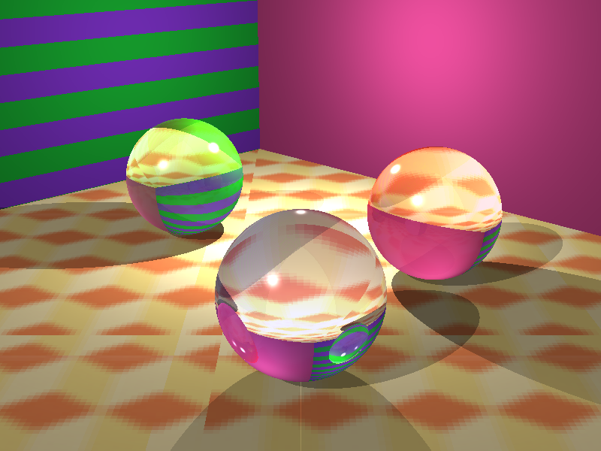
Sequential Raytracer

Slide 3

Sequential Raytracer

Slide 4


Slide 5
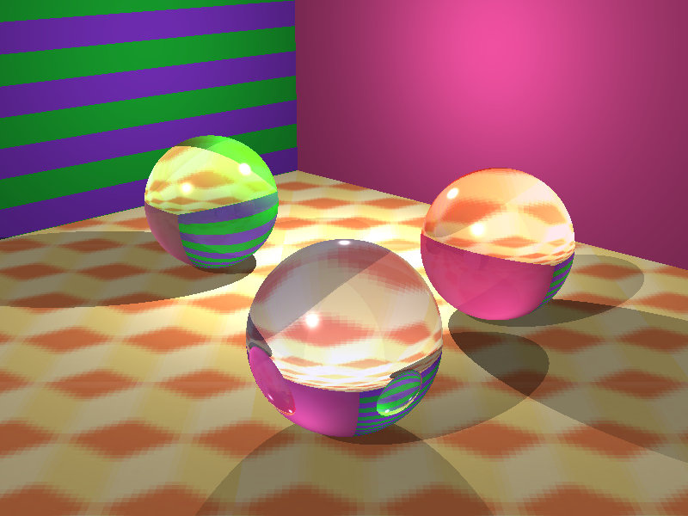
OpenCL Raytracer

Slide 6
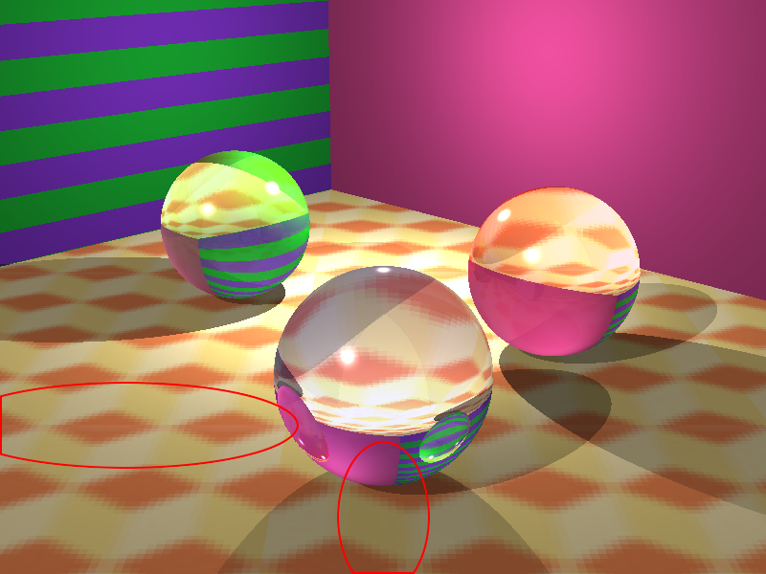
OpenCL Raytracer

Slide 7
PROBLEMS

Slide 8
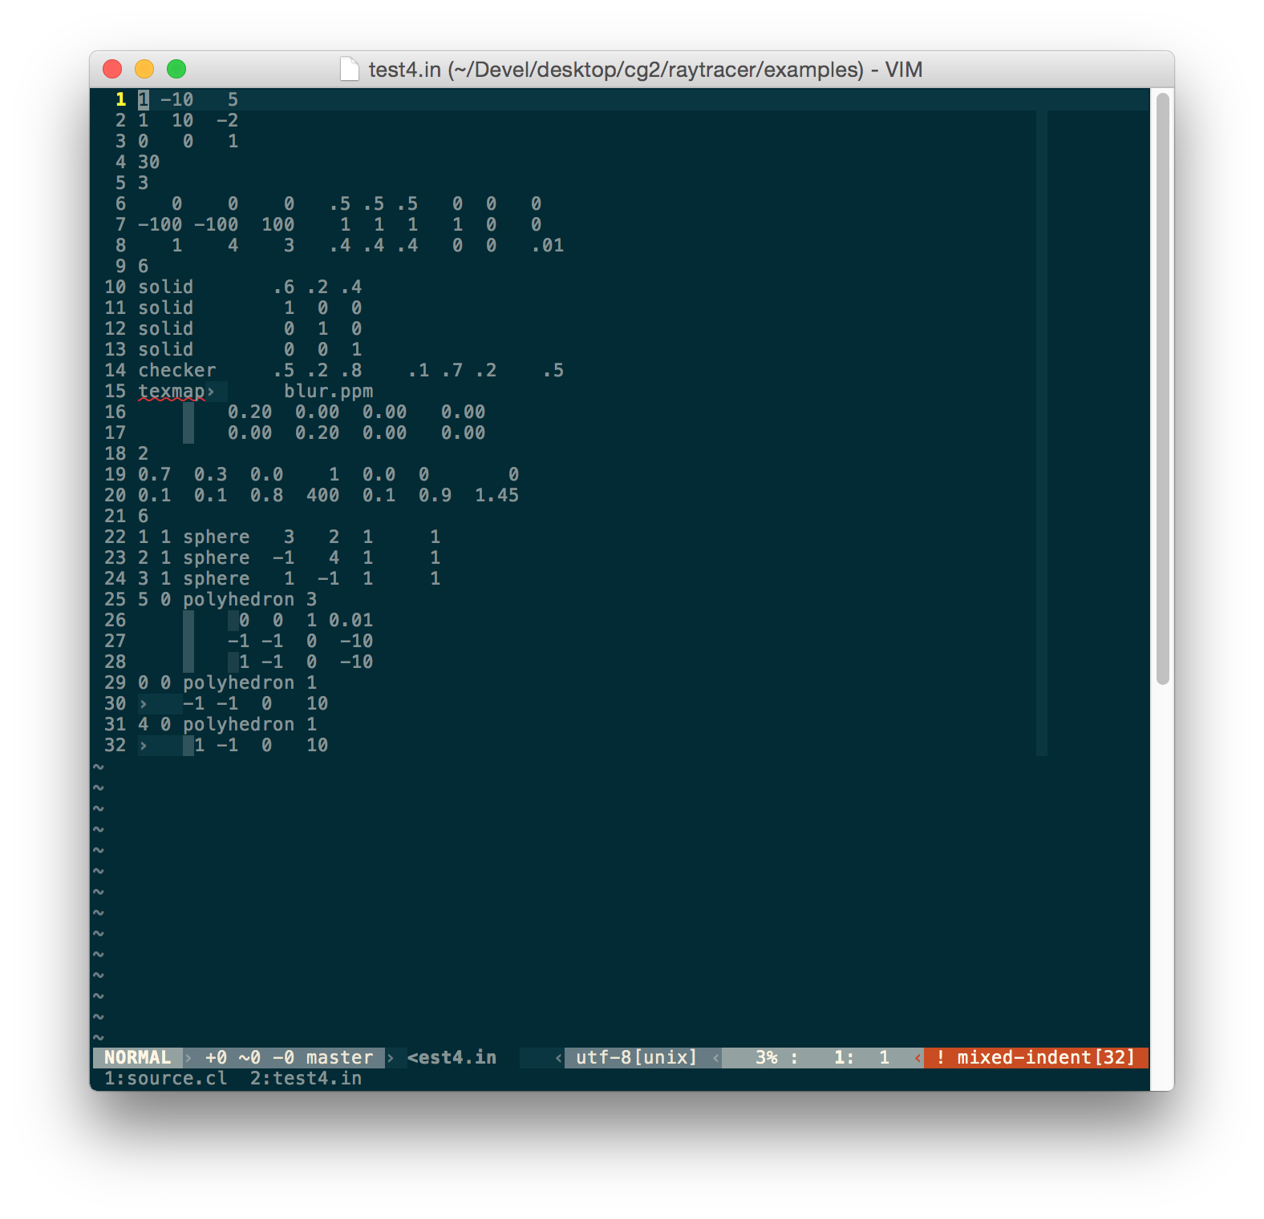
TRANSFER SCENE SPECIFICATION TO DEVICE

Slide 9
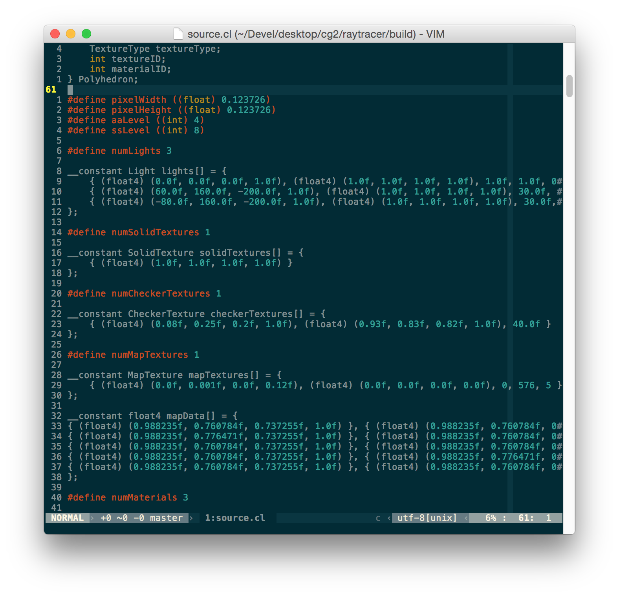
TRANSFER SCENE SPECIFICATION TO DEVICE

Slide 10
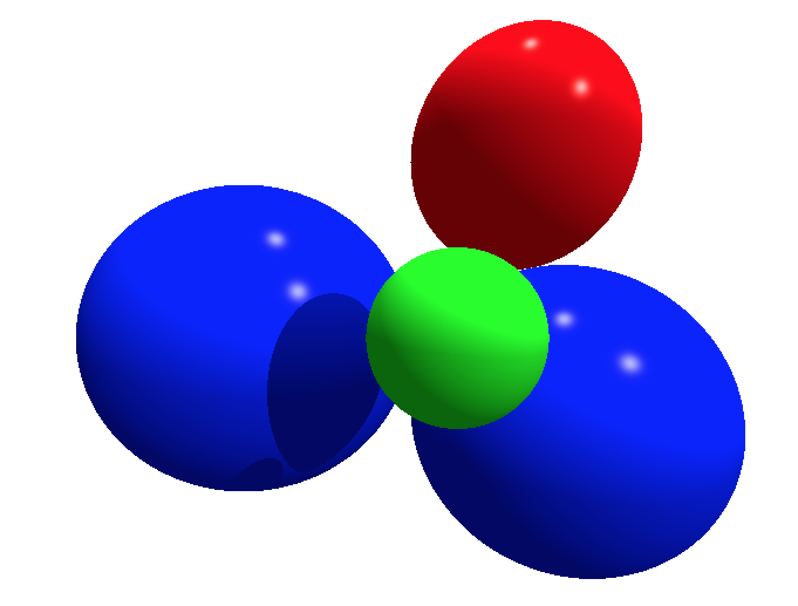
Correct

Slide 11
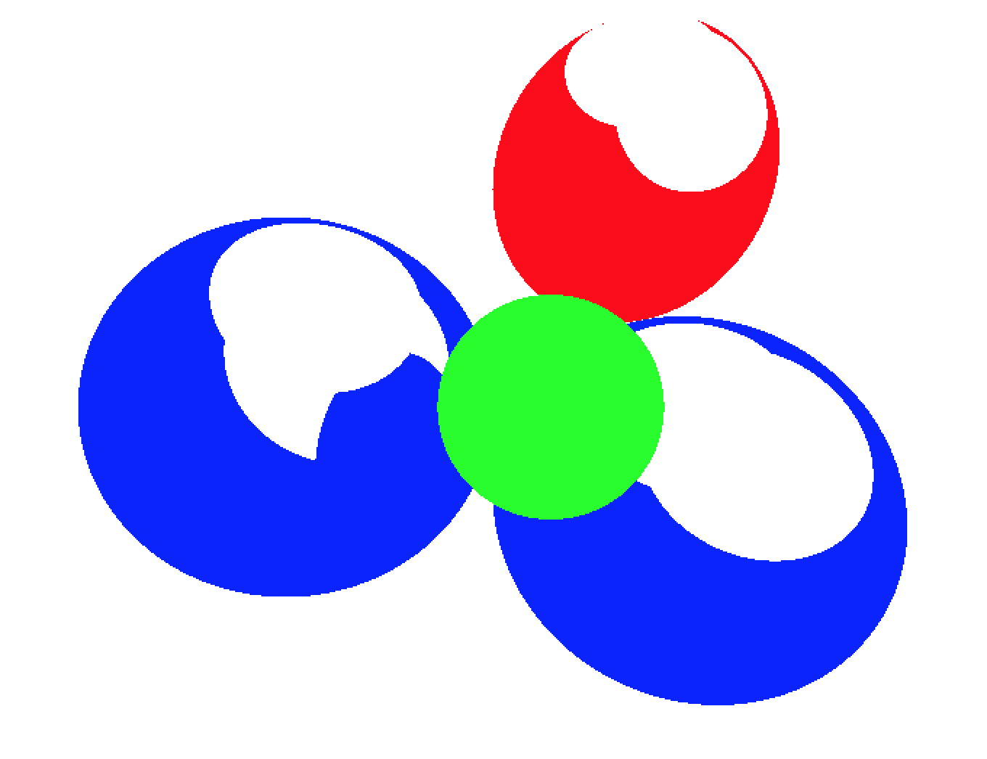
PROBLEMS

Slide 12
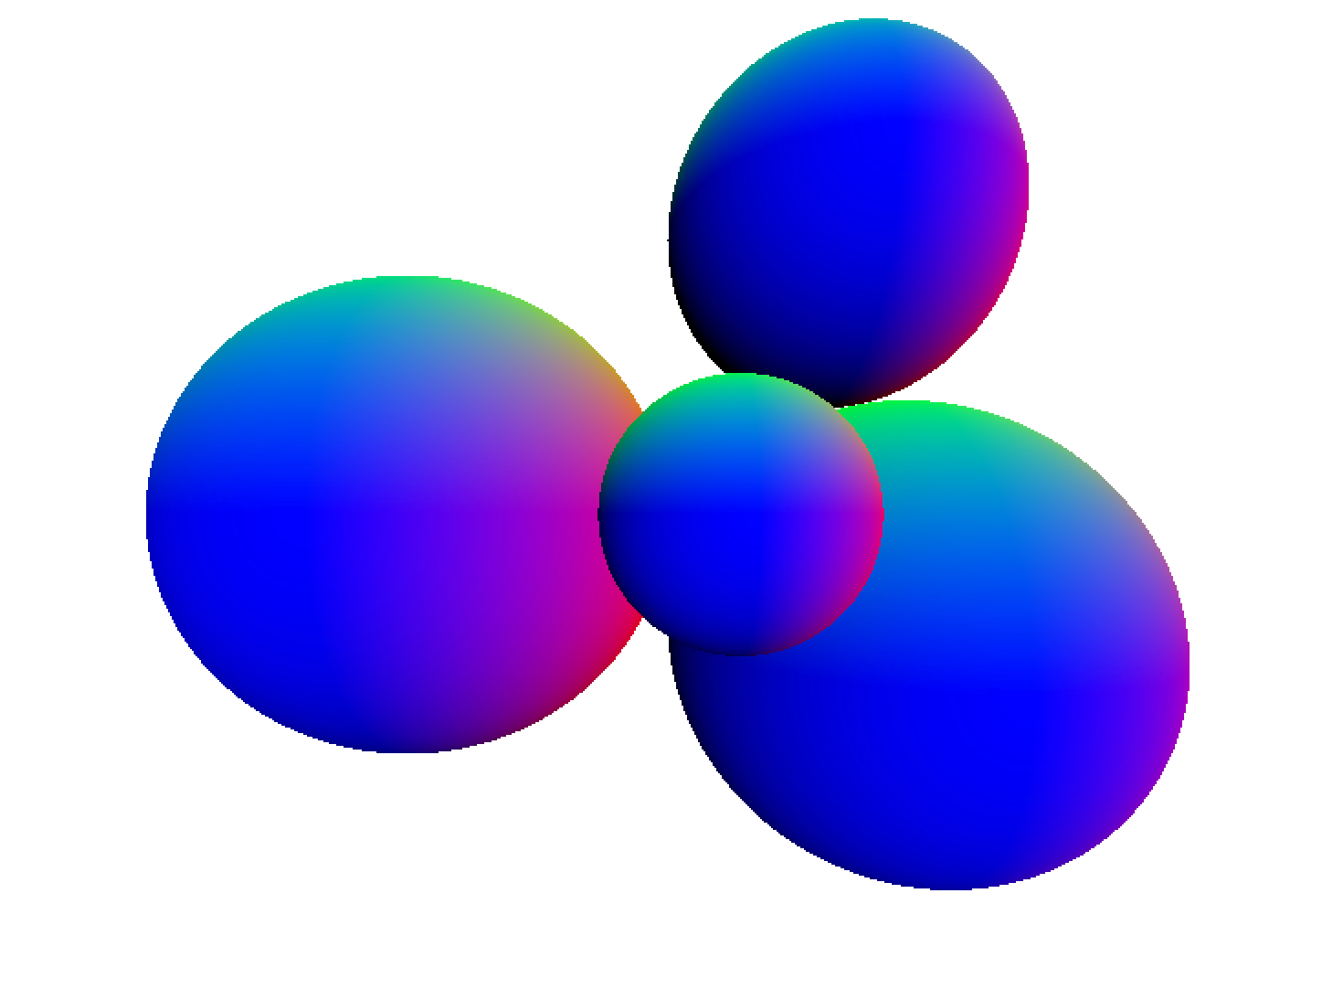
Correct

Slide 13
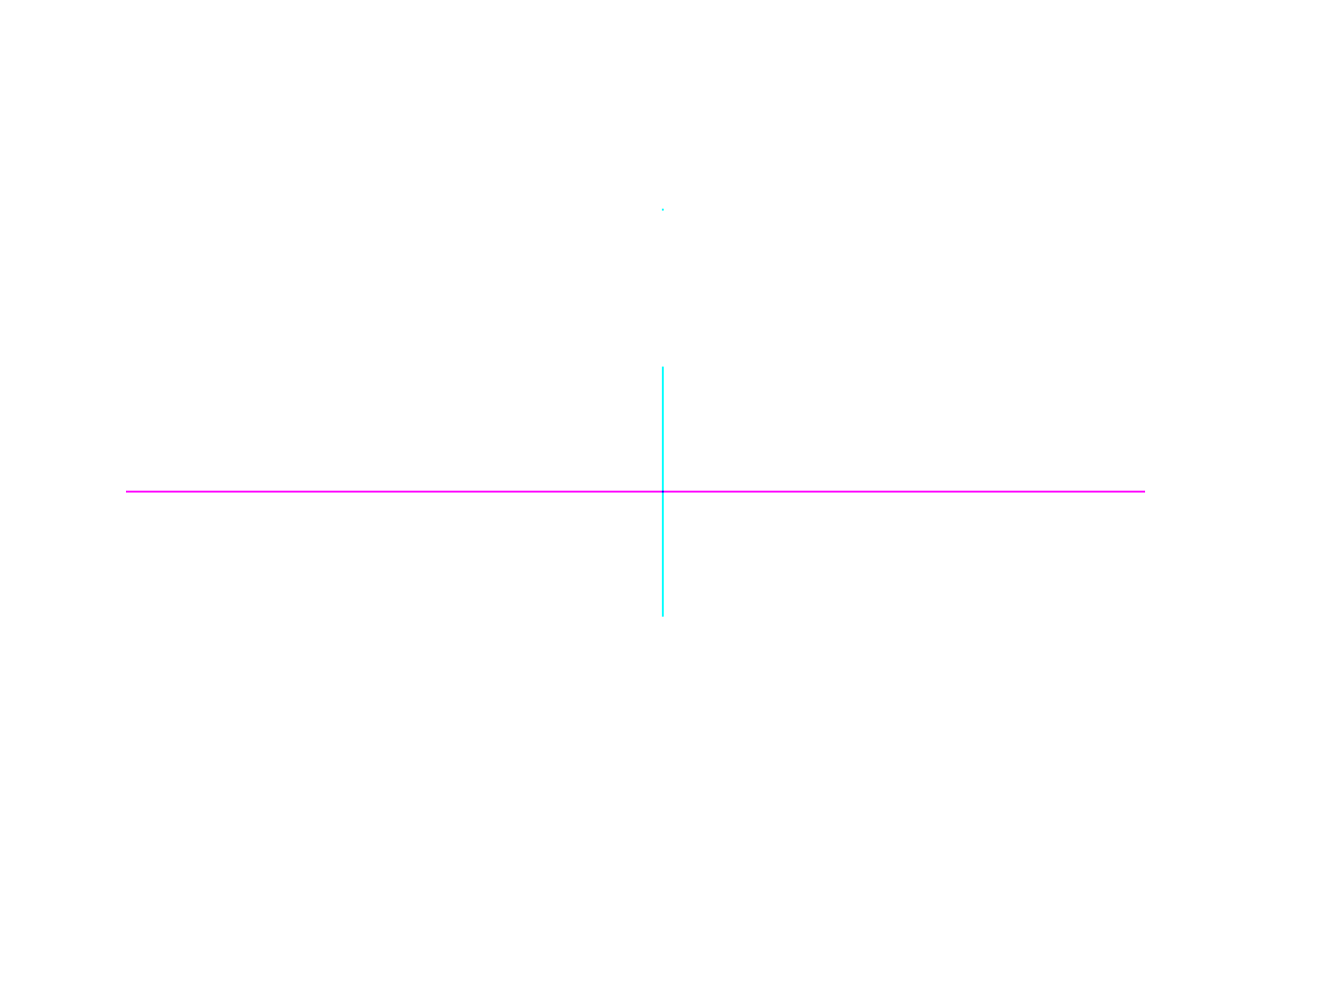
WAT

Slide 14

SHIT

Slide 15
Correct

Slide 16
THANK GOD

Slide 17
FINALLY

Slide 18
CORRECT

Slide 19
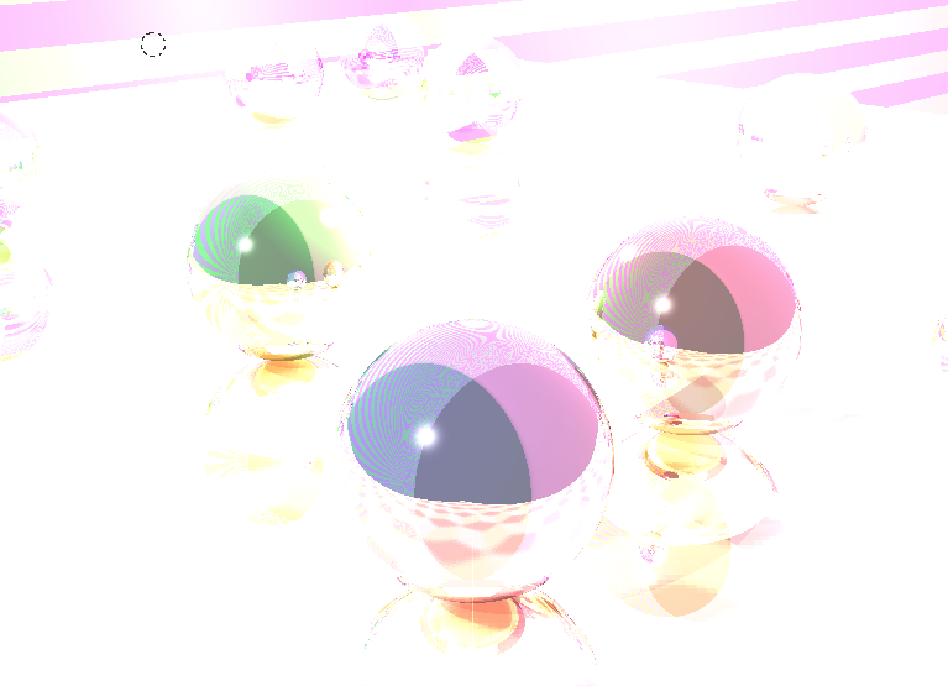
NOT… RIGHT

Slide 20
OpenCL Raytracer Options
Anti Aliasing (Supersampling)
Soft Shadows

Slide 21
test4

Slide 22
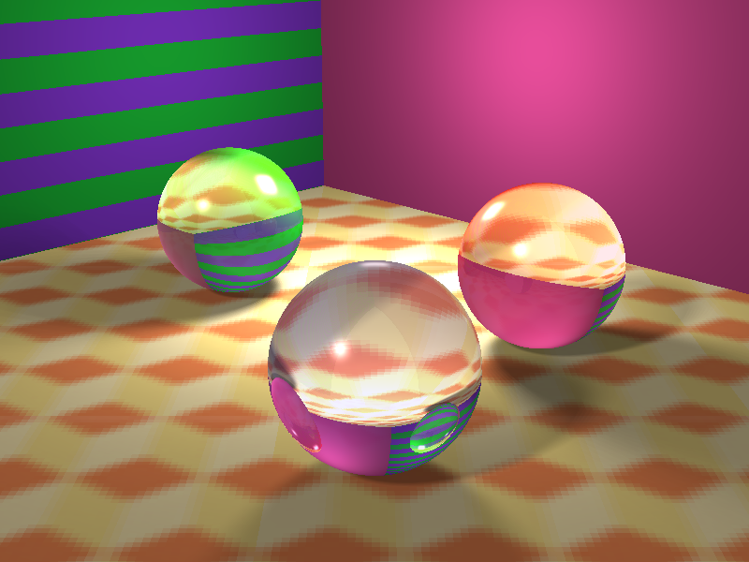
Test4 --ss 8

Slide 23

Test4 --ss 8 --AA 4

Slide 24
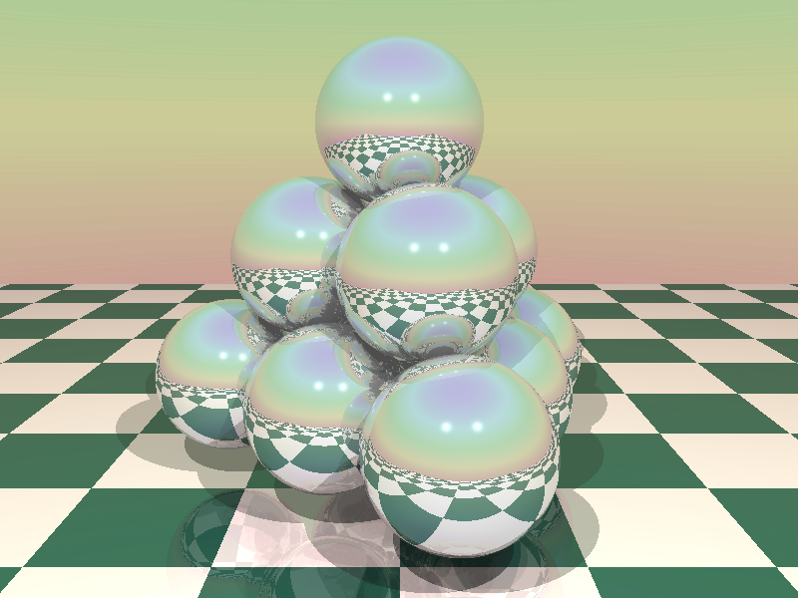
Test5

Slide 25

Test5 --SS8

Slide 26

Test5 --SS8 --AA4

Slide 27
PERFORMANCE (GTX 670)

Slide 28
PERFORMANCE (GTX 670)
Sequential CPU
Test1: ~1810ms
Test4: ~4841ms
Test5: ~5515ms

Slide 29
PERFORMANCE (GTX 670)
Sequential CPU
Test1: ~1810ms
Test4: ~4841ms
Test5: ~5515ms
OpenCL
Test1: ~18ms
Test4: ~22ms
Test5: ~31ms

Slide 30
PERFORMANCE (GTX 670)
Sequential CPU
Test1: ~1810ms
Test4: ~4841ms
Test5: ~5515ms
OpenCL
Test1: ~18ms
Test4: ~22ms
Test5: ~31ms
OpenCL --SS8
Test1: ~54ms
Test4: ~185ms
Test5: ~508ms

Slide 31
PERFORMANCE (GTX 670)
Sequential CPU
Test1: ~1810ms
Test4: ~4841ms
Test5: ~5515ms
OpenCL
Test1: ~18ms
Test4: ~22ms
Test5: ~31ms
OpenCL --SS8
Test1: ~54ms
Test4: ~185ms
Test5: ~508ms
OpenCL --SS8 --AA2
Test1: ~140ms
Test4: ~700ms
Test5: ~2015ms

Slide 32
PERFORMANCE (GTX 670)
Sequential CPU
Test1: ~1810ms
Test4: ~4841ms
Test5: ~5515ms
OpenCL
Test1: ~18ms
Test4: ~22ms
Test5: ~31ms
OpenCL --SS8
Test1: ~54ms
Test4: ~185ms
Test5: ~508ms
OpenCL --SS8 --AA2
Test1: ~140ms
Test4: ~700ms
Test5: ~2015ms
OpenCL --SS8 –AA4
Test1: ~546ms
Test4: ~2762ms

Slide 33
PERFORMANCE (GTX 670)
Sequential CPU
Test1: ~1810ms
Test4: ~4841ms
Test5: ~5515ms
OpenCL
Test1: ~18ms
Test4: ~22ms
Test5: ~31ms
OpenCL --SS8
Test1: ~54ms
Test4: ~185ms
Test5: ~508ms
OpenCL --SS8 --AA2
Test1: ~140ms
Test4: ~700ms
Test5: ~2015ms
OpenCL --SS8 –AA4
Test1: ~546ms
Test4: ~2762ms
Test5: Driver Crashou

Slide 34
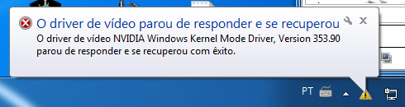

Slide 35
PERFORMANCE (GTX 670)
Sequential CPU
Test1: ~1810ms
Test4: ~4841ms
Test5: ~5515ms
OpenCL
Test1: ~18ms
Test4: ~22ms
Test5: ~31ms
OpenCL --SS8
Test1: ~54ms
Test4: ~185ms
Test5: ~508ms
OpenCL --SS8 --AA2
Test1: ~140ms
Test4: ~700ms
Test5: ~2015ms
OpenCL --SS8 –AA4
Test1: ~546ms
Test4: ~2762ms
OpenCL --SS8 –AA4 OS X CPU
Test1: ~11821ms
Test4: ~53842ms
Test5: ~155802ms

Slide 36
PERFORMANCE (GTX 670)
Sequential CPU
Test1: ~1810ms
Test4: ~4841ms
Test5: ~5515ms
OpenCL
Test1: ~18ms
Test4: ~22ms
Test5: ~31ms
OpenCL --SS8
Test1: ~54ms
Test4: ~185ms
Test5: ~508ms
OpenCL --SS8 --AA2
Test1: ~140ms
Test4: ~700ms
Test5: ~2015ms
OpenCL --SS8 –AA4
Test1: ~546ms
Test4: ~2762ms
OpenCL --SS8 –AA4 OS X CPU
Test1: ~11821ms
Test4: ~53842ms
Test5: ~155802ms

Slide 37
!!!!!!!!!
PERFORMANCE (GTX 670)
Sequential CPU
Test1: ~1810ms
Test4: ~4841ms
Test5: ~5515ms
OpenCL
Test1: ~18ms
Test4: ~22ms
Test5: ~31ms
OpenCL --SS8
Test1: ~54ms
Test4: ~185ms
Test5: ~508ms
OpenCL --SS8 --AA2
Test1: ~140ms
Test4: ~700ms
Test5: ~2015ms
OpenCL --SS8 –AA4
Test1: ~546ms
Test4: ~2762ms
OpenCL --SS8 –AA4 OS X CPU
Test1: ~11821ms
Test4: ~53842ms
Test5: ~155802ms

Slide 38
REALTIME?

Slide 39
Faltou tempo T_T

Slide 40
Faltou tempo T_T
Mas possível!

